Slide 1


Technical Design Thinking II
Spring 2025
Algorithms & LabVIEW Basics
Dr. Bruce McFall

Slide 2
Algorithm
A procedure for solving a problem in a FINITE number of steps
Typically contains five major types of instructions
Input/Output
Activities or Mathematical Operations
Binary Decisions (Yes/No)
Repetition (Loops)
Accumulation/Storage
Algorithms can be described by:
Textual Descriptions (Highly Recommended)
Flowcharts (not recommended – academic world)

Slide 3

Algorithm – Textual Description
The first step in detailing a problem/algorithm is a textual description
Why?
It’s the natural first step for anyone when looking at a problem/algorithm
Continue to break the problem down using textual descriptions of functional / process steps until you get to How!
Think Before You Do Anything!

Slide 4
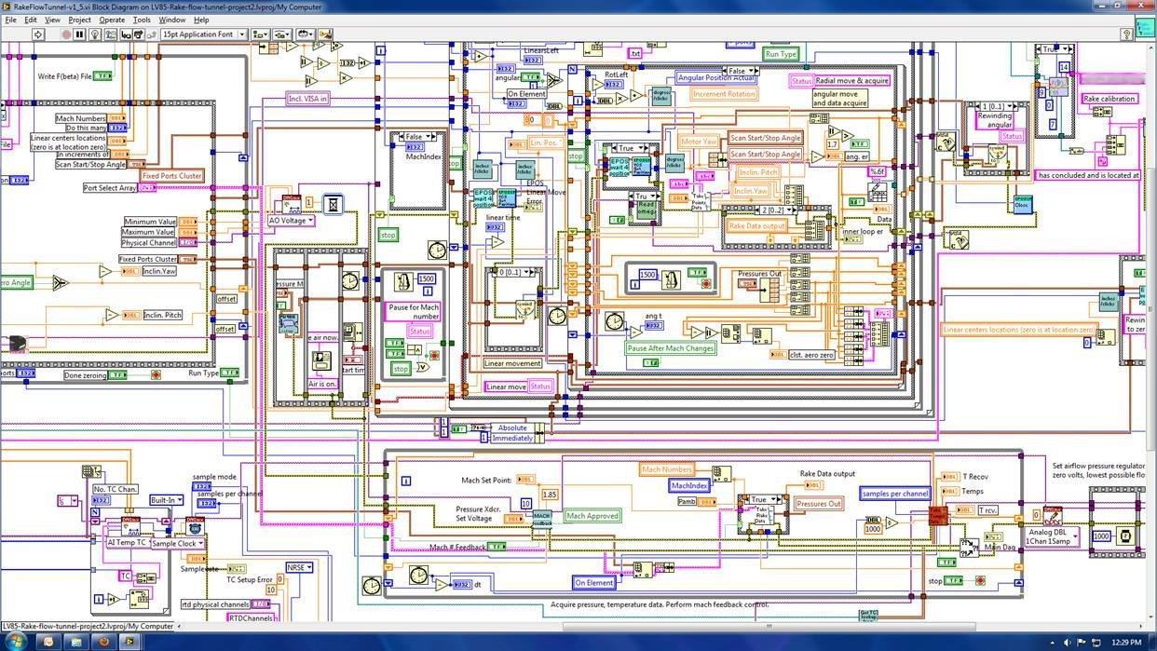
What you don’t want when using LabVIEW

Slide 5
Well Structured and Well Commented Software
How do you avoid the previous LabVIEW disaster in particular? In fact avoid it with Software in general?
Functional Decomposition
Provides Structure & Comments
System Architecture
Hardware Architecture
EV 3 Architecture
Calibration
Motors
Sensors
Structural Architecture
Positioning
Motors
Sensors

Slide 6
Well Structured and Well Commented Software
Functional Decomposition – Continued
Provides Structure & Comments
System Architecture – continued
Software Architecture
Calibration
Motors
Sensors
Path Following
.
.
.
To be continued for each team

Slide 7
Well Structured and Well Commented Software
Functional Decomposition
Comments
Describe “what it does” not “how”
Add information, don’t repeat info from the software
For subVI’s add information to the “Description”
What is expected for the input/output(s) – if the inputs/outputs don’t have descriptive enough names
Describe possible error conditions
Describe algorithms if they are complex
If putting comments in the diagram, don’t overlay wires
Etc…
Now, using this basic information and the initial parts of the System Architecture, complete a total Functional Decomposition of the project using the desired comment structure

Slide 8
LabVIEW – Short Introductions for Basic Elements
Writing your first LabVIEW program
Data Flow Programming Basics
LabVIEW Data Types
Creating SubVI’s in LabVIEW
Using Charts & Graphs in LabVIEW
Using Debugging Tools in LabVIEW
Using the Tools Palette in LabVIEW
Using Arrays in LabVIEW
Using LabVIEW Case Structures
Using Loops in LabVIEW

Slide 9
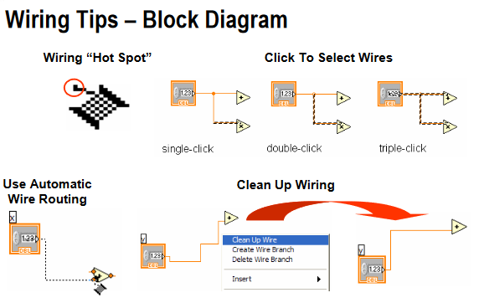
LabVIEW Tips & Tricks

